Slide 1


Spotify ETL project
By:
Srivathsav Mitnala

Slide 2

Foundation
Ever wondered you have been listening to the same music for a while
My natural instinct is to listen to songs I really like
What makes these songs special?
Why listen to these songs in particular?
Data has been collected to answer these and other questions

Slide 3

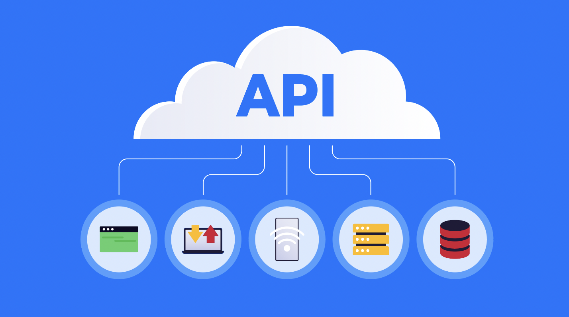
Extracting the data
Using the spotipy library on Python, user’s recently played tracks are collected.
Spotify allows users to collect 50 tracks at a time
Next, different songs and their features were collected
Album details collected from last.fm API

Slide 4
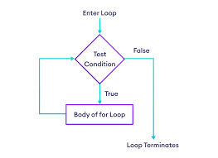


Transforming the data
Data collected was in JSON format, it was transformed by iteration and forming a dataframe.
This requires the simple usage of for loops

Slide 5
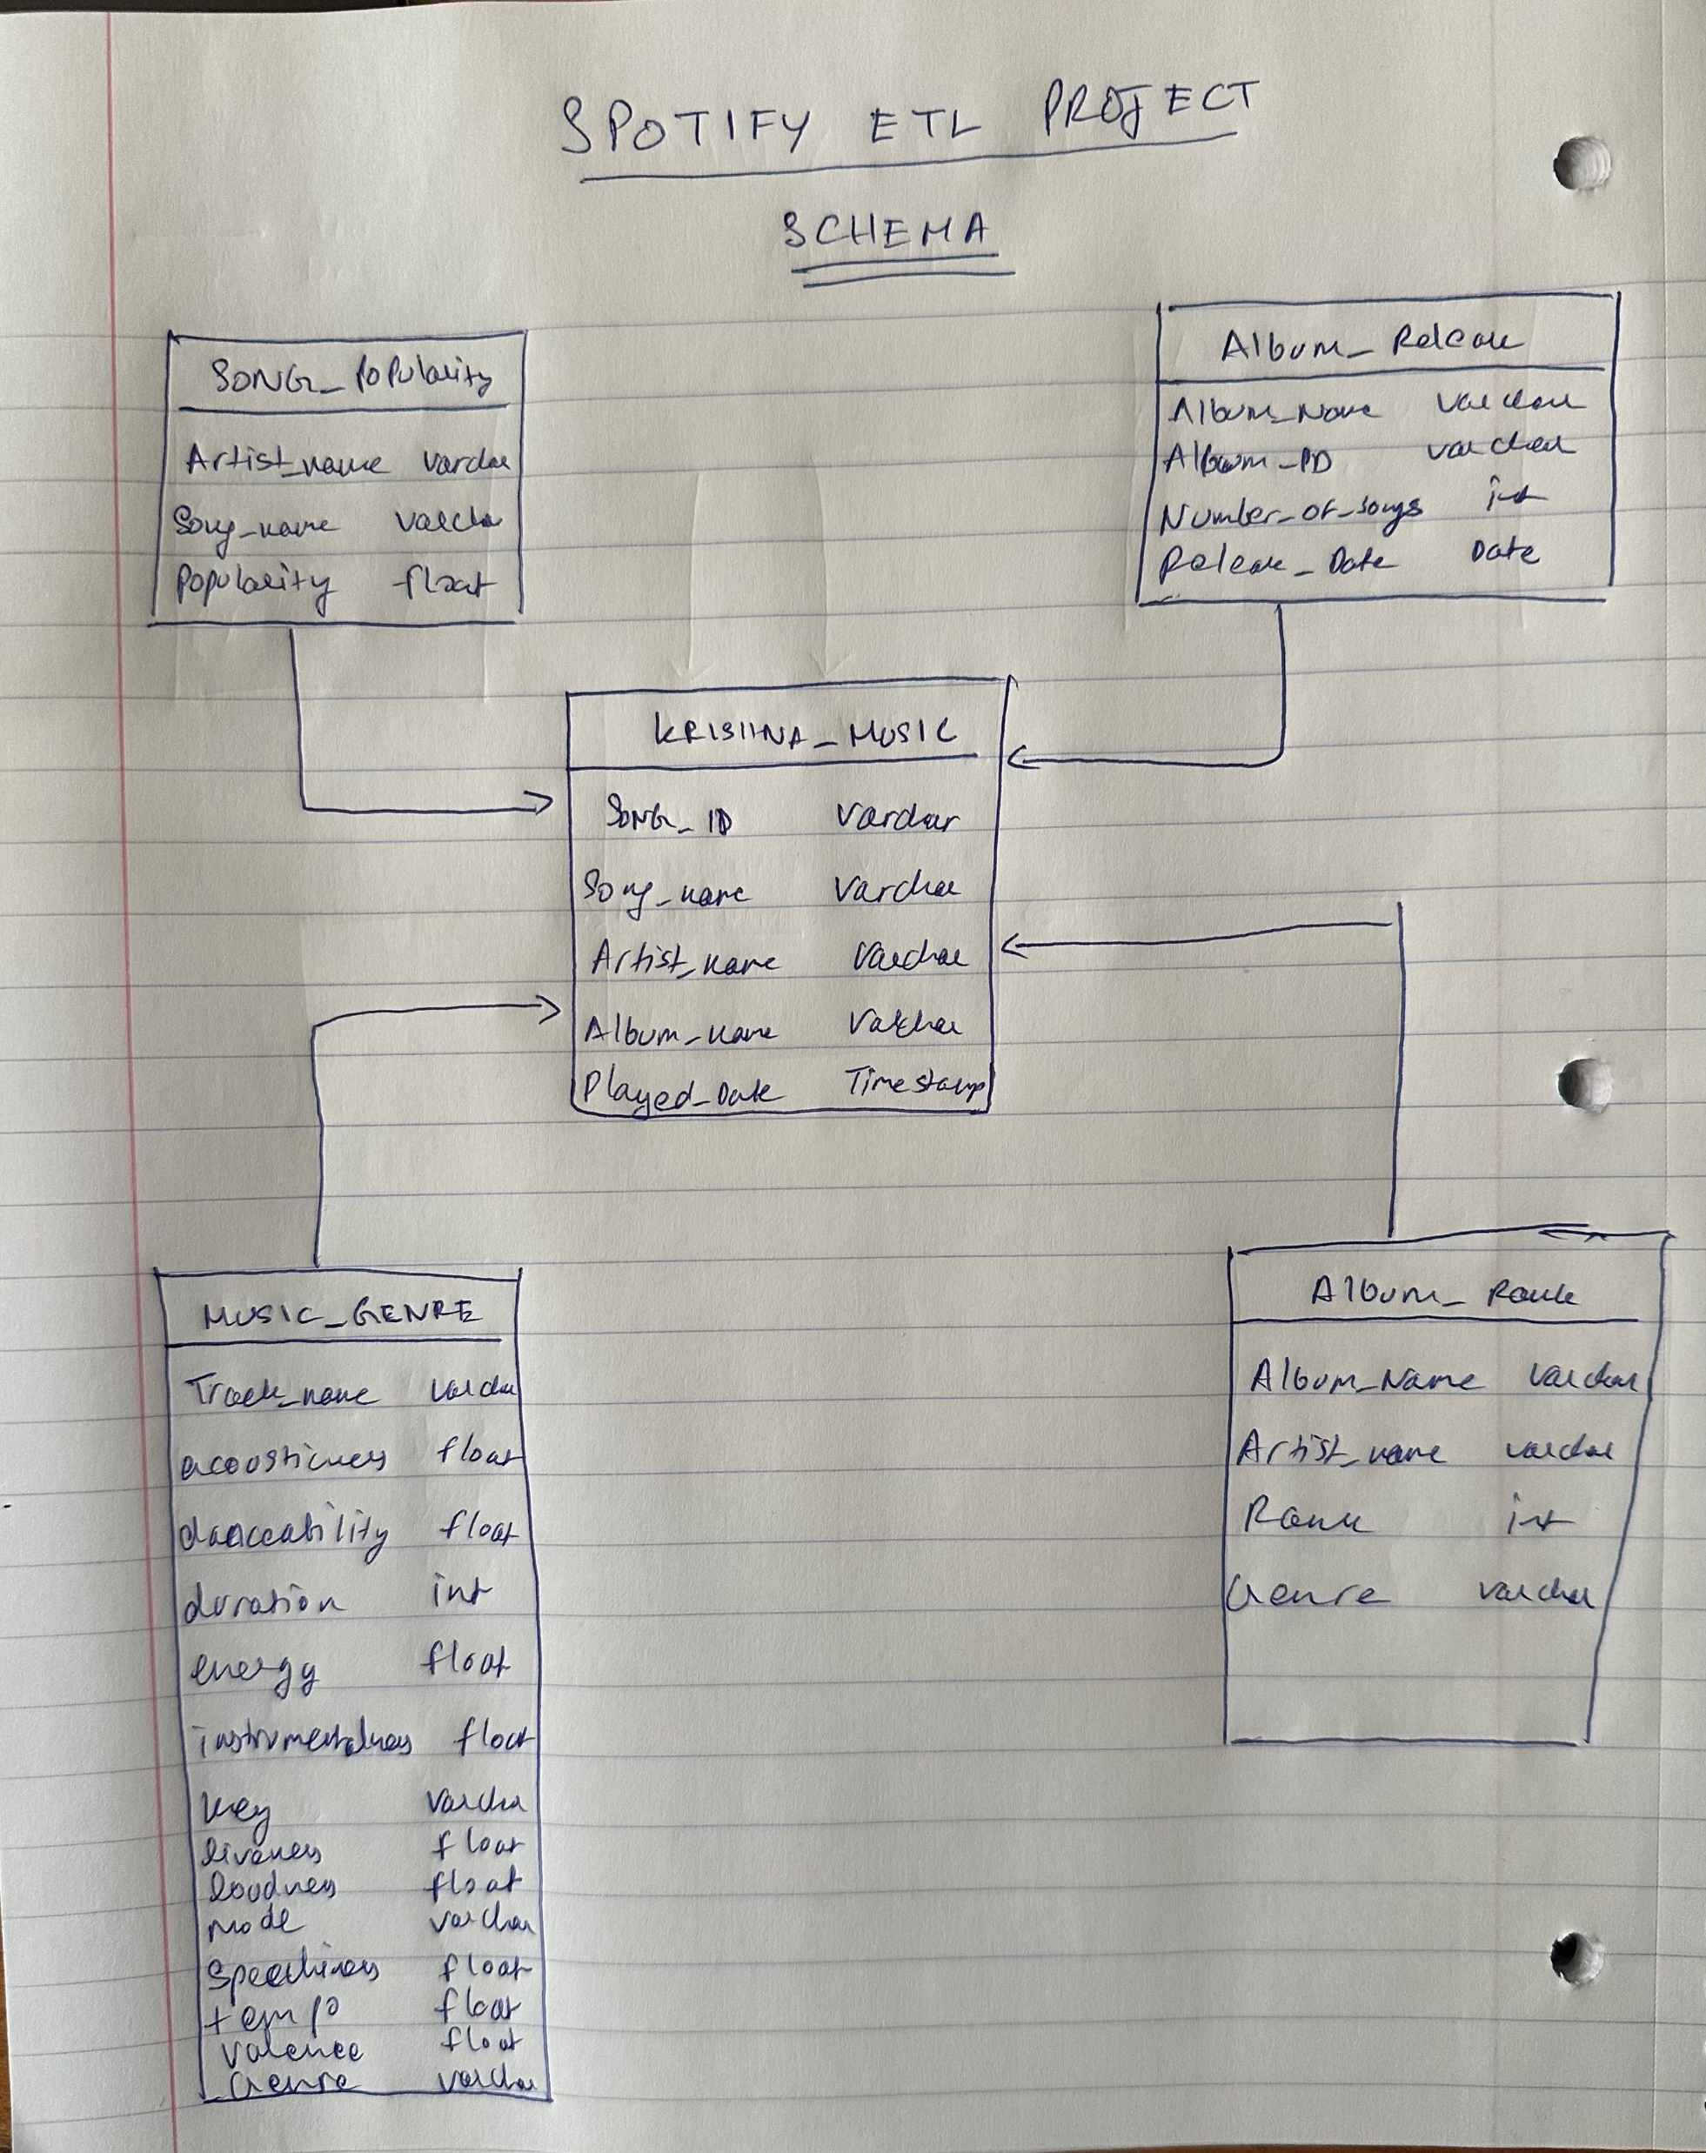
This was the Data Architecture that was visualized
Before loading it into a Datawarehouse.

Slide 6


Loading the data
Snowflake was the Datawarehouse chosen for this project.
Connected using credentials
Created required tables with specific primary and foreign key conditions
Loaded the data from the dataframes onto the tables on snowflake

Slide 7
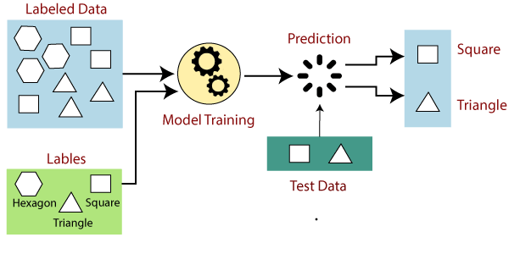
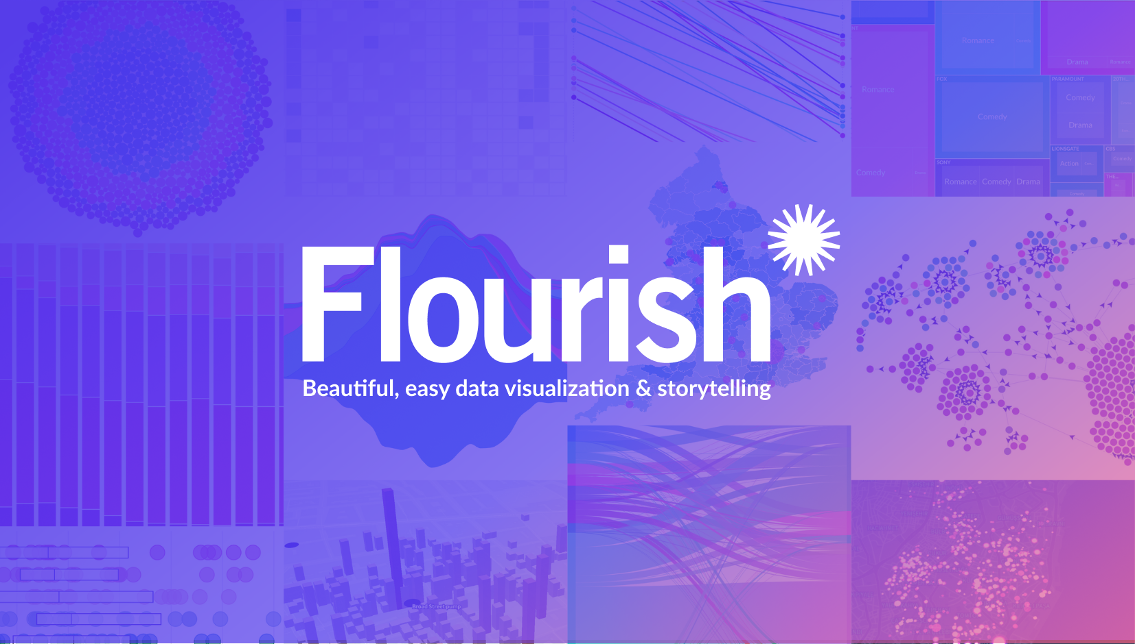
Analysis
Cluster Algorithm Data Analysis on Music Genre Data
Classification model performance Analysis on Music Genre Data
Visualizations of Music listened to

